Slide 1
SDAH 109-MARVELOUS GRACE ENGLISH TWI
Marvelous grace of our loving Lord.
Grace that exceeds our sin and our guilt!
Yonder on Calvary's mount outpoured
There where the blood of the Lamb was spilt.
Yεn Aw’rade dכfo dom nwanwa,
כdom a εb’ro yεn bכne so,
A wohwie guu Kalbre bepכ so
‘Hכna wohwiee ‘Guammaa mogya gui.

Slide 2
SDAH 109-MARVELOUS GRACE ENGLISH TWI
Refrain:
Grace, grace, God's grace,
Grace that will pardon and cleanse within
Grace, grace, God's grace,
Grace that is greater than all our sin!
Nnyeso:
‘Dom, ‘dom, ‘S’ro ‘dom,
‘Dom a εde bכn’ kyε, tew yεn mu;
‘Dom, ‘dom, ‘S’ro ‘dom,
‘Dom a εb’ro bכne nyinaa so.

Slide 3
SDAH 109-MARVELOUS GRACE ENGLISH TWI
Sin and despair, like the sea waves cold,
Threaten the soul with infinite loss;
Grace that is greater yes grace untold
Points to the Refuge, the mighty Cross.
Bכne ne abasamtu te sε
‘S’rכkye de כy’ra huna kra no;
כdom kεse, nea enni kabea
Kyerε yεn guankכbea ‘sεnnua no.

Slide 4
SDAH 109-MARVELOUS GRACE ENGLISH TWI
Refrain:
Grace, grace, God's grace,
Grace that will pardon and cleanse within
Grace, grace, God's grace,
Grace that is greater than all our sin!
Nnyeso:
‘Dom, ‘dom, ‘S’ro ‘dom,
‘Dom a εde bכn’ kyε, tew yεn mu;
‘Dom, ‘dom, ‘S’ro ‘dom,
‘Dom a εb’ro bכne nyinaa so.

Slide 5
SDAH 109-MARVELOUS GRACE ENGLISH TWI
Marvelous, infinite, matchless grace,
Freely bestowed on all who believe!
You that are longing to see His face,
Will you this moment His grace receive?
כdom nwanwa a enni kabea,
Wכde ma nea כgye di no kwa!
Mo a morep’re ahu N’anim,
So mobεgye Ne dom no seesei?

Slide 6
SDAH 109-MARVELOUS GRACE ENGLISH TWI
Refrain:
Grace, grace, God's grace,
Grace that will pardon and cleanse within
Grace, grace, God's grace,
Grace that is greater than all our sin!
Nnyeso:
‘Dom, ‘dom, ‘S’ro ‘dom,
‘Dom a εde bכn’ kyε, tew yεn mu;
‘Dom, ‘dom, ‘S’ro ‘dom,
‘Dom a εb’ro bכne nyinaa so.

Slide 7
OPPOSING SIN AGAINST GOD: BELIEVER, BEWARE
Notes:
Contrariety opposition means the state or quality of opposing or being contrary

Slide 8
PROVERBS 8:36
“Na deɛ ɔfom me no di ne kra aborɔ, wɔn a wɔtane me nyinaa dɔ owuɔ”.

Slide 9
INTRODUCTION
Sin's opposing God declares that we desire to do evil and wicked nature of sin.
Clearly and undeniably, as our text says, sin displeases and dishonors God.
The carnal mind or sin is called enmity itself (Rom. 8:7).
Indeed, it is contrariety and enmity itself.
Notes:
Verse 7 Ɛfiri sɛ honam adwene yɛ nitan a ɛtane Onyankopɔn na ɛmfa ne ho nhyɛ Nyankopɔn mmara no aseɛ, na mpo ɛntumi;
Versr 8 Na wɔn a wɔwɔ honam mu no ntumi nɔs Nyankopɔn ani.

Slide 10
THE RESULT OF SIN
We walk opposing to God (Lev. 26:21).
We rebel against God (Isa. 1:2).
We rise up against Him as an enemy (Micah 2:8).
We strive and contend with Him (Isa. 45:9).
We despise God (Num. 11:20).
We become resisters of God (Acts 7:51),
We become fighters against God (Acts 5:39,23:9)
In the end we say there is no God (Psalm 12:1)
Notes:
Lev. 26:21 And if ye walk contrary unto me, and will not hearken unto me; I will bring seven times more plagues upon you according to your sins.
Isa. 1:2 Hear, O heavens, and give ear, O earth: for the LORD hath spoken, I have nourished and brought up children, and they have rebelled against me.
Micah 2:8 Even of late my people is risen up as an enemy: ye pull off the robe with the garment from them that pass by securely as men averse from war.
Isa. 45:9 Woe unto him that striveth with his Maker! [Let] the potsherd [strive] with the potsherds of the earth. Shall the clay say to him that fashioneth it, What makest thou? or thy work, He hath no hands?
Num. 11:20 [But] even a whole month, until it come out at your nostrils, and it be loathsome unto you: because that ye have despised the LORD which [is] among you, and have wept before him, saying, Why came we forth out of Egypt?
Acts 7:52 Which of the prophets have not your fathers persecuted? and they have slain them which showed before of the coming of the Just One; of whom ye have been now the betrayers and murderers:

Slide 11
WHY EVERY BELIEVER SHOULD BEWARE OF SIN
Sin is opposes the nature of God. (Hab. 1:13)
Sin opposes God as a ruler. (Exodus 5:2, Jere. 2:31)
Sin denies God's all –sufficiency.
Notes:
Hab. 1:13 [Thou art] of purer eyes than to behold evil, and canst not look on iniquity: wherefore lookest thou upon them that deal treacherously, [and] holdest thy tongue when the wicked devoureth [the man that is] more righteous than he?
Exodus 5:2 And Pharaoh said, Who [is] the LORD, that I should obey his voice to let Israel go? I know not the LORD, neither will I let Israel go.

Slide 12
WHY EVERY BELIEVER SHOULD BEWARE OF SIN
Sin opposes the justice of God, and dares God to His worst Malachi 2:17.
Sin disowns God as all- knowing
Sin despises the riches of God's goodness, Romans 2:4
Notes:
Malachi 2:17 Ye have wearied the LORD with your words. Yet ye say, Wherein have we wearied [him]? When ye say, Every one that doeth evil [is] good in the sight of the LORD, and he delighteth in them; or, Where [is] the God of judgment?
Romans 2:4 Or despisest thou the riches of his goodness and forbearance and longsuffering; not knowing that the goodness of God leadeth thee to repentance?

Slide 13
WHY EVERY BELIEVER SHOULD BEWARE OF SIN
Sin turns God's grace into wantonness, Jude 4.
Sin is contrary to the Works of God.
Sin is contrary to the Law and will of God.
Sin is contrary to the image of God.
Notes:
Jude 1:4 For there are certain men crept in unawares, who were before of old ordained to this condemnation, ungodly men, turning the grace of our God into lasciviousness, and denying the only Lord God, and our Lord Jesus Christ.
It is against all the rules and orders of God's appointment Sin is not only a transgression of, but also a contradiction to the will of God. Sin is an anti-will to God's will; it sets itself to oppose preaching, prayer and the institution of God, Lev. 26:14-15,21,23,27; Ezek. 11:21
God made man in His own likeness, in righteousness and true holiness Eph. 4:24. Sin is the devil's image and likeness. Sinners are as much like the devil as anything 1 John 3:8; John 8:44.

Slide 14
WHY EVERY BELIEVER SHOULD BEWARE OF SIN
Sin is contrary to the people and children of God.
Sin is contrary to, and set against the glory of God, and all that should and would give glory to Him, or has any tendency to do so.
Sin is contrary and opposite to the being and existence of God.
Notes:
Sin is also bent on hindering, all it can, the comfort, welfare and happiness of the saints. 1 Peter 5:8
It gives out false reports of God and goodness lays prejudices and rocks of offence and stumbling in men's ways, that they may be out of love with all that is good. In other that men may not believe and for that matter give glory to God, sin employs the devil to blind their eyes 2 Corinthians 4:4. Sin is bent against the honor of God.
It makes the sinner wish and endeavor that there might be no God, for sinners are haters of God, Rom, 1:30. Sin keeps garrisons and strongholds against God 2 Cor. 10:4,5. It strives with and fights against God.

Slide 15
LET ME ASK THESE QUESTIONS
Can you find it in your heart to hug and embrace such a monster as this?
Will you love that which hates God and which God hates?
Will you join yourself to that which nothing but contrariety to God and all that is good?
Notes:
In short, sin is the dare of God's justice, the rape of His mercy, the jeer of His patience, the slight of His power, the contempt of His love, the upbraiding of His providence, the scoff of His promise, the reproach of His wisdom as one writer prettily expresses this ugly thing.

Slide 16
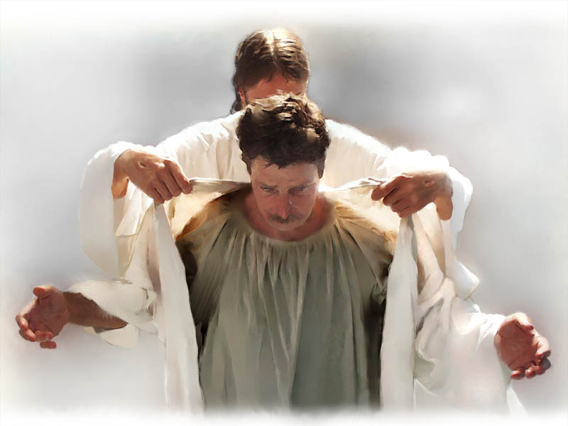
Tonight I entreat you to be on God’s side and depart from the tent of wickedness.

